Slide 1


Slide 2
How did you learn to read?
Can you remember?

Slide 3
Book-by-book-by-book?

Slide 4
Phonics is for adults - not just for ‘infants’!
What do we do when we want to read an unknown word?
Calceolaria integrifolia

Slide 5
The official guidance in England:
Teachers should use Systematic Synthetic Phonics programmes and ‘cumulative’ decodable reading books for beginners

Slide 6
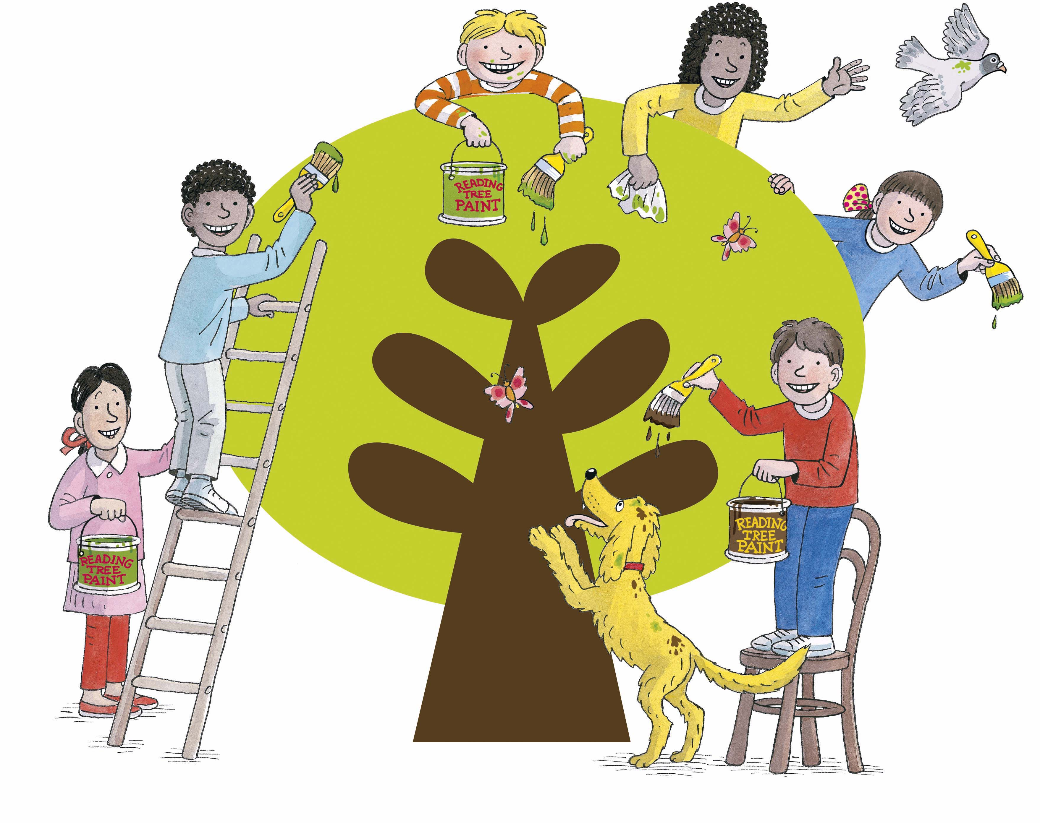
Our school uses the
Oxford Reading Tree
Floppy’s Phonics programme
By Oxford University Press
and Debbie Hepplewhite

Slide 7
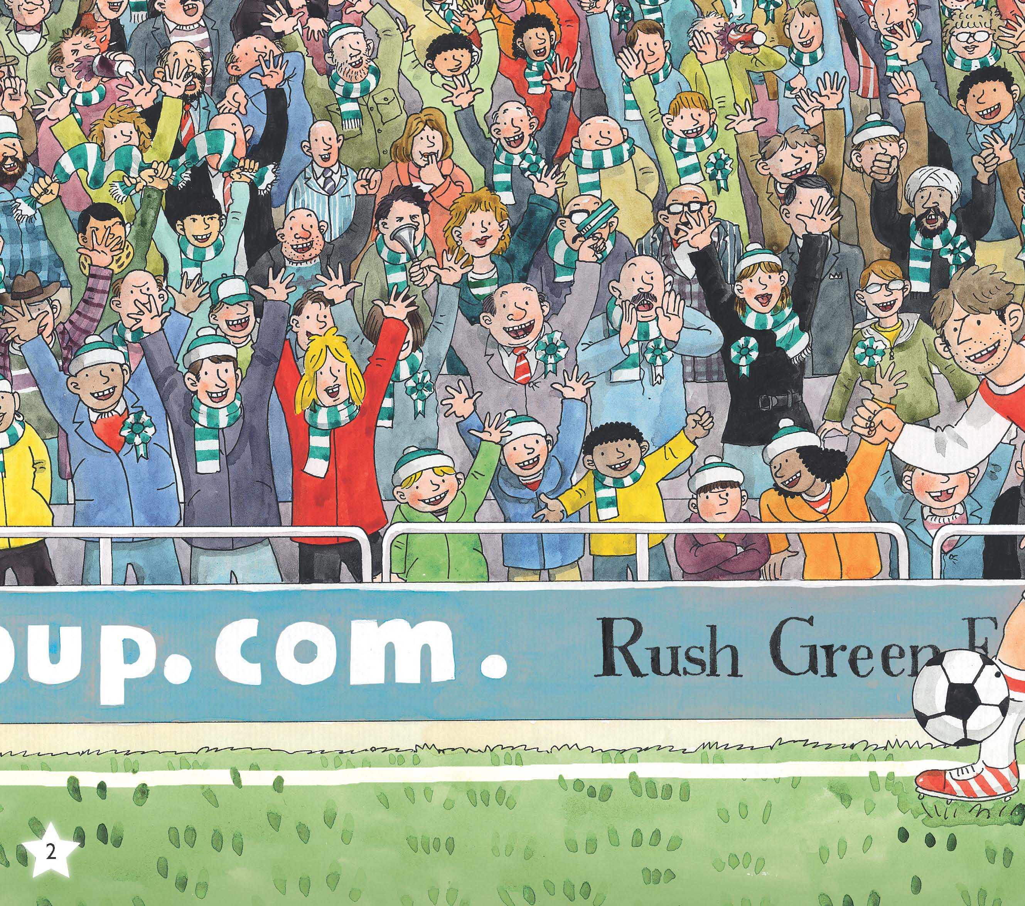
Pre-phonics
Sounds:
environmental
rhythm, rhyme
singing, chanting
percussion, music
discussion!
oral blending and segmenting

Slide 8
Oral blending and oral segmenting
1. Reading without letters:
Say, “Pull up the /z//i//p/ on your /c//oa//t/.”
2. Spelling without letters:
“Mat, /m/ /a/ /t/. Spoon /s/ /p/ /oo/ /n/.”
This helps your child’s awareness of sounds.

Slide 9
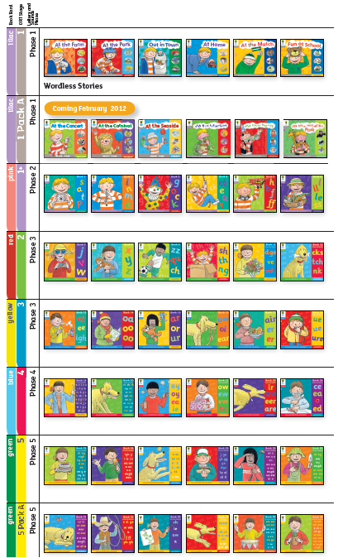
Systematic…
Pre-phonics
Letters start here
2 years+ for reading and spelling
Revisit code after that for spelling purposes

Slide 10
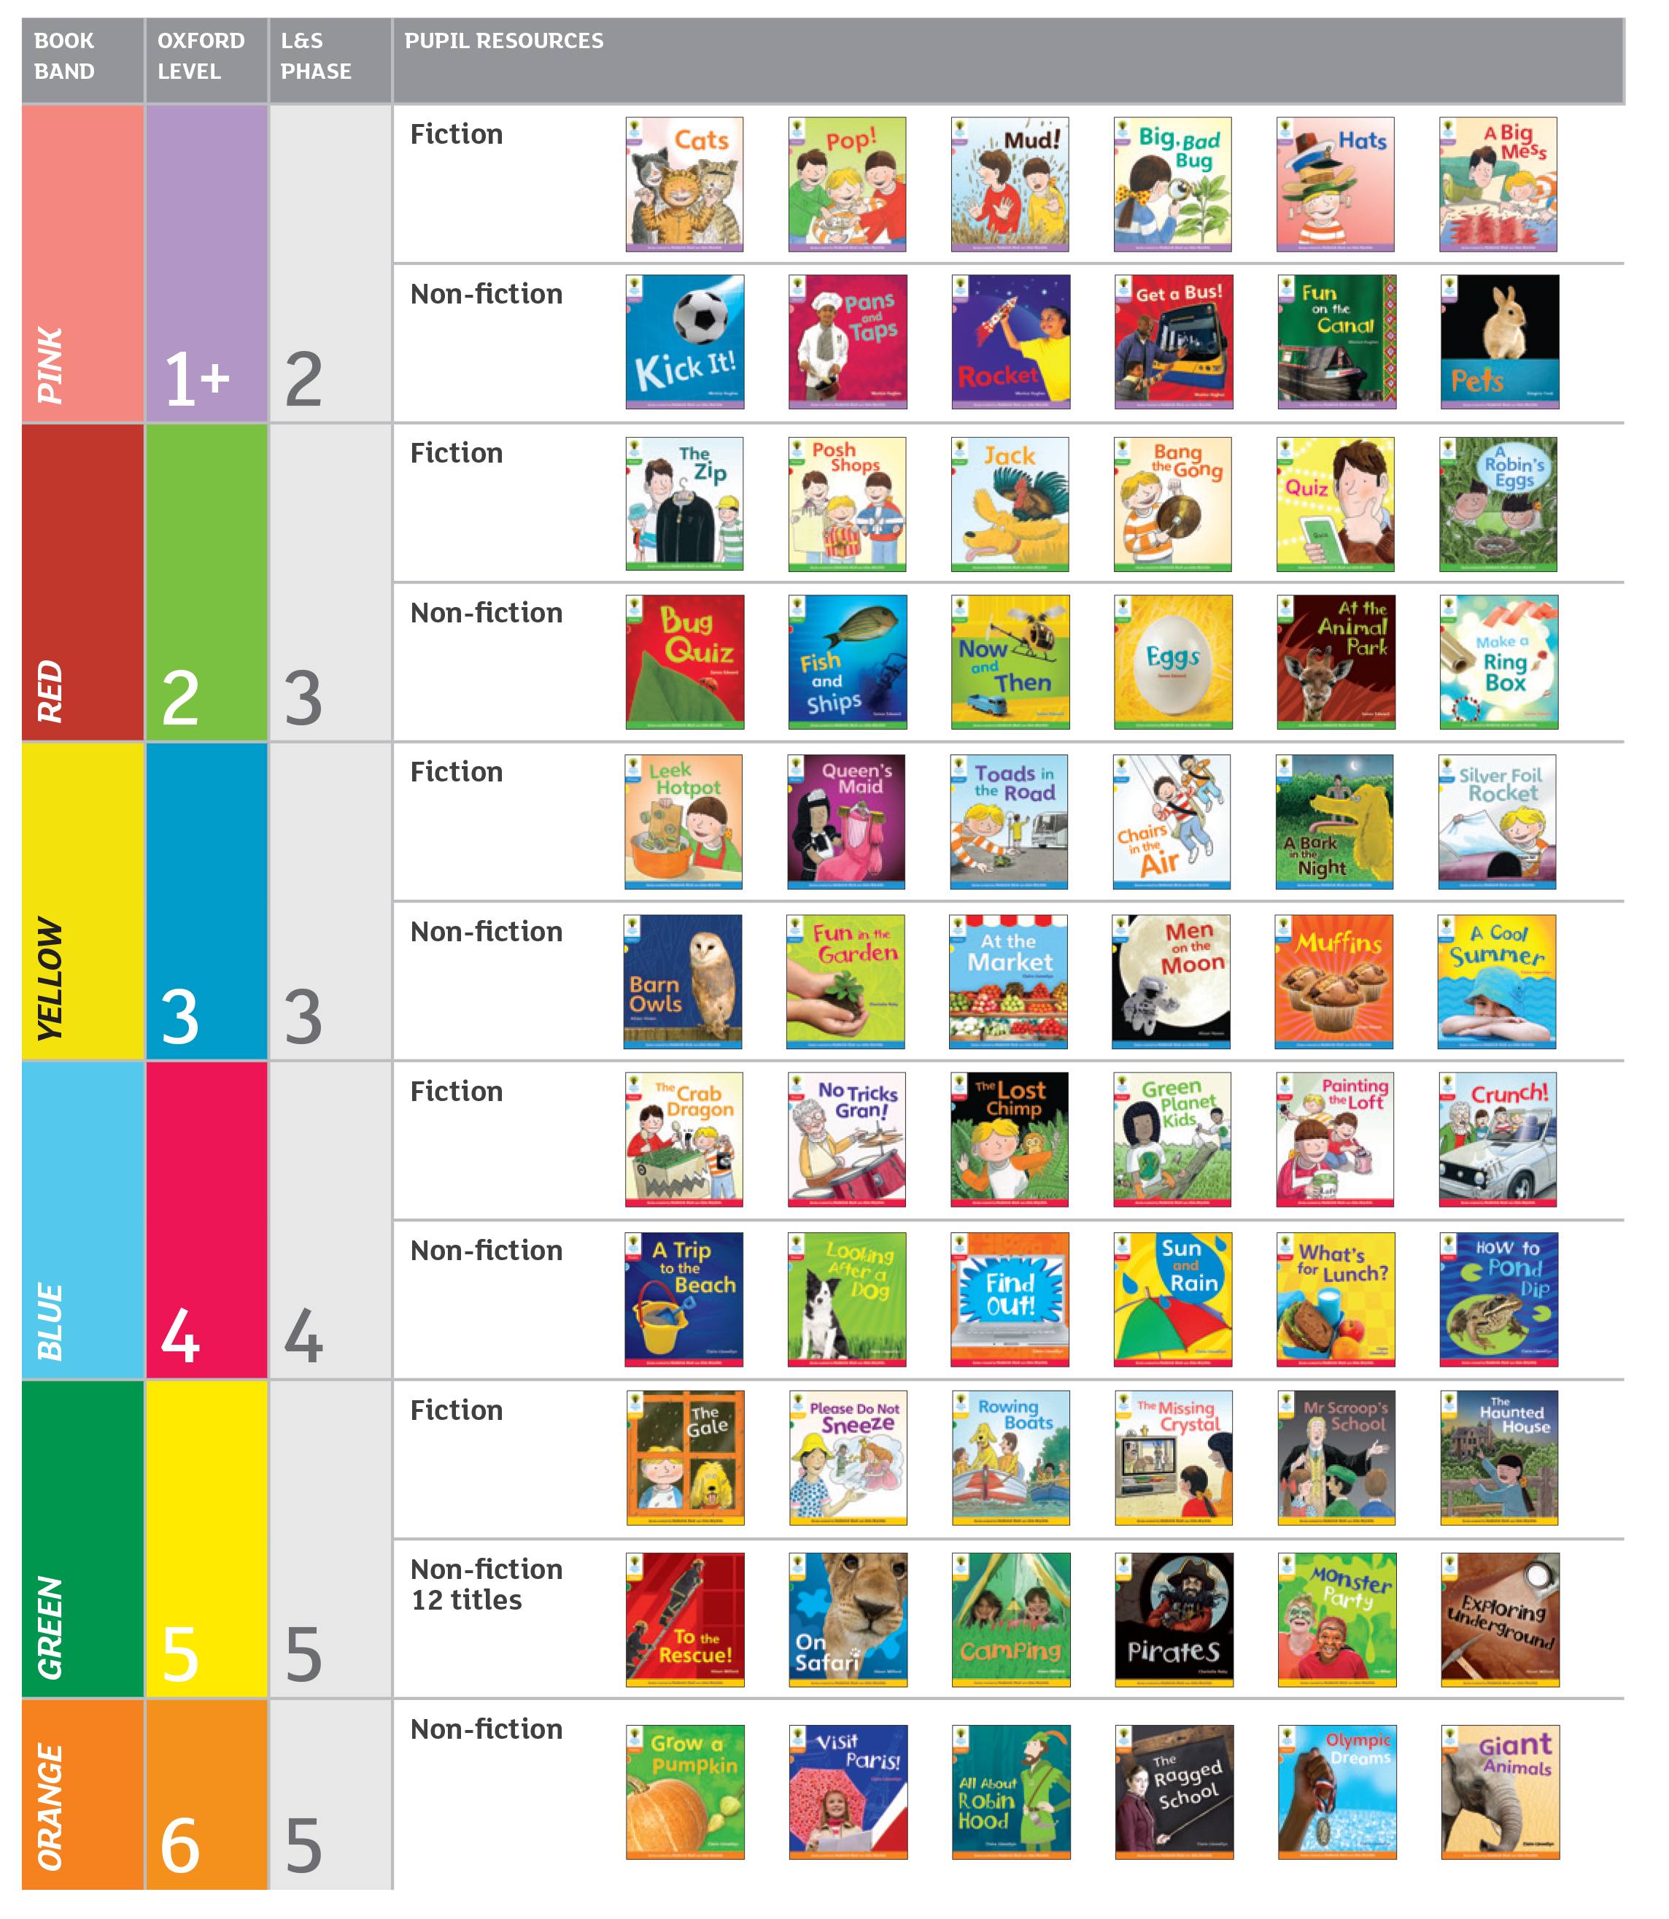
Floppy’s Phonics Fiction and Non-fiction
Use cumulative, decodable reading books as well as the Floppy’s Phonics programme.
Slightly behind phonics in class.

Slide 11


Non-decodable books
To be read by an adult to or with the child.
These are language rich and allow children to listen to repetitive stories and further develop their knowledge and understanding of the world.

Slide 12
About the alphabetic code
Letters and letter groups are code for the individual sounds in our speech.
Decoding the letter symbols into sounds is the basis for reading (print-to-sound):
See the printed word soap, say the sounds
/s/ /oa/ /p/, blend the sounds to read “soap”.

Slide 13
For beginners, we teach the letters and sounds of the alphabetic code in a ‘simple’ way at first...
We teach all the sounds and at least one way of spelling them: e.g. /ee/ ee
Then we continue to teach further spelling alternatives which are code for the sounds:
e.g. /ee/ ee ea e e-e -y -ey -ie

Slide 14
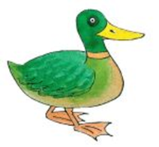



Floppy’s Phonics Aids to Memory
/k/
c a t k ey d u ck
Pictures and words makes the learning of the different sounds and spellings memorable and manageable.

Slide 15

How the adult supports the learner to read is very important...
Tell the child the code:
straight In this word, these letters
are code for /ai/.

Slide 16
2. Alternatively, model the sounding out and blending of the word to the child.
3. Or simply tell the child the words which are proving too difficult.

Slide 17
‘Tricky Words’
Useful words which are sometimes ‘tricky’ are introduced steadily throughout phonics.
It is better to tell the child a really challenging word, than to tell the child to ‘guess’ the word.

Slide 18
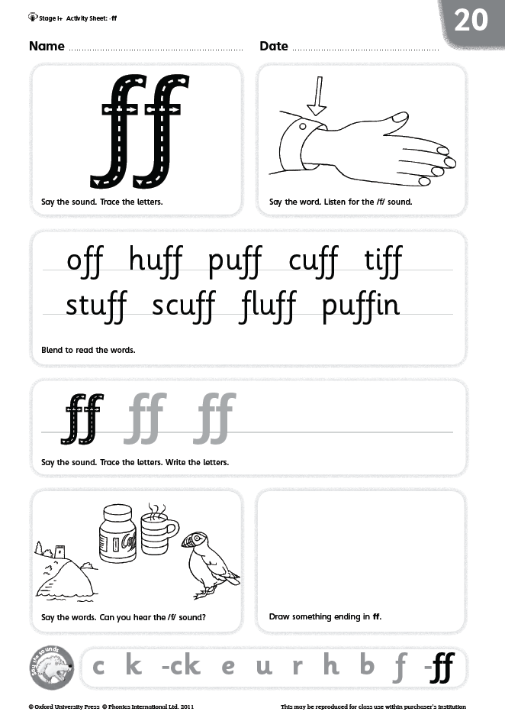
Phonics Journals - Activity Sheets
Individual practice of the
skills for reading, spelling
and handwriting at word level.
Children are fully trained
in the routines.

Slide 19
PLEASE:
Listen to your child read to you and support as needed (AND talk a lot about the story)
Read books aloud to your child
Share the reading of books with your child
Continue to hear your child read aloud even when he or she can read independently
Chatter about everything!

Slide 20
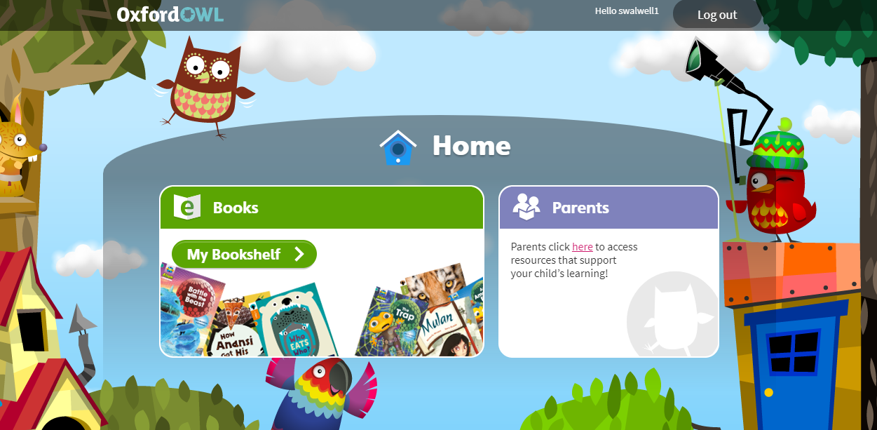
Oxford Owl website
swalwell1 password

Slide 21
Thank you for coming!
Please do come and see us if you have any questions or worries.

