Slide 1
Young
Carers
Young Carers' Day
16th March 2021

Slide 2


Who is a young carer?
A young carer is somebody aged 5 -18 years old who helps look after somebody at home.
This could be a parent, brother or sister, grandparent or another person who lives with you and needs help to look after themselves as they have a disability or illness.

Slide 3

Why might people need support at home?
Physical disability
Learning disability
Illness/ poor health
Mental health
Notes:
I usually expand on mental health. Words you may have heard like depressed or anxious and what this might look like eg mam or dad might find it hard to do fun thing and not have a lot of energy or may look sad, not like going out

Slide 4

How a young carer may help at home
Help practically round the home e.g. cleaning , cooking , putting the washing in, washing dishes etc.
Help somebody physically e.g. helping somebody out of bed.
Keep somebody company and make sure they are ok.
Have to let mam or dad help a sibling.
Help somebody say what they want / communicate for them.
Not go to loud or busy places.
Young carers are amazing!

Slide 5


Being a young carer can be hard sometimes. Young carers might:
Feel tired
Struggle at school or with homework
Feel angry, worried, sad or scared
Worry what people might think.
Not have as much time to see friends or do things they enjoy.
This Photo by Unknown Author is licensed under CC BY-NC

Slide 6
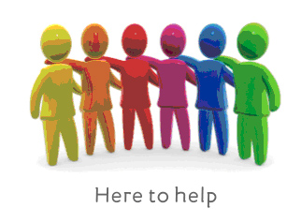
Support for Young Carers in school
  Somebody to talk to
  Worry boxes/ talking teddy in class
  Support with homework
  After school clubs to have fun and a break from your caring role
  Special arrangements where possible to help support young carers
Young carers can also be referred to a young carers service who can provide social activities, outings, online games and extra support to young carers and their families
If you'd like to talk more about being a young carer you can talk with an adult you trust in school or our school's 'Young Carers Champions'
Mrs Waugh and Miss Doyle
This Photo by Unknown Author is licensed under CC BY

Slide 7

You can be a good friend to somebody who is a young carer by:
Being UNDERSTANDING now you know what it means to be a young carer.
Invite EVERYBODY to play.
Be KIND if somebody can't come out to play, ask them another time or play with them at school.
DON’T be unkind.
Say kind words and make people feel HAPPY and PROUD of being a young carer.

